Slide 1
Conceptual Replication of Rentzsch & Gross’ (2015) Study 5
Carson Koffler
12/03/2025

Slide 2
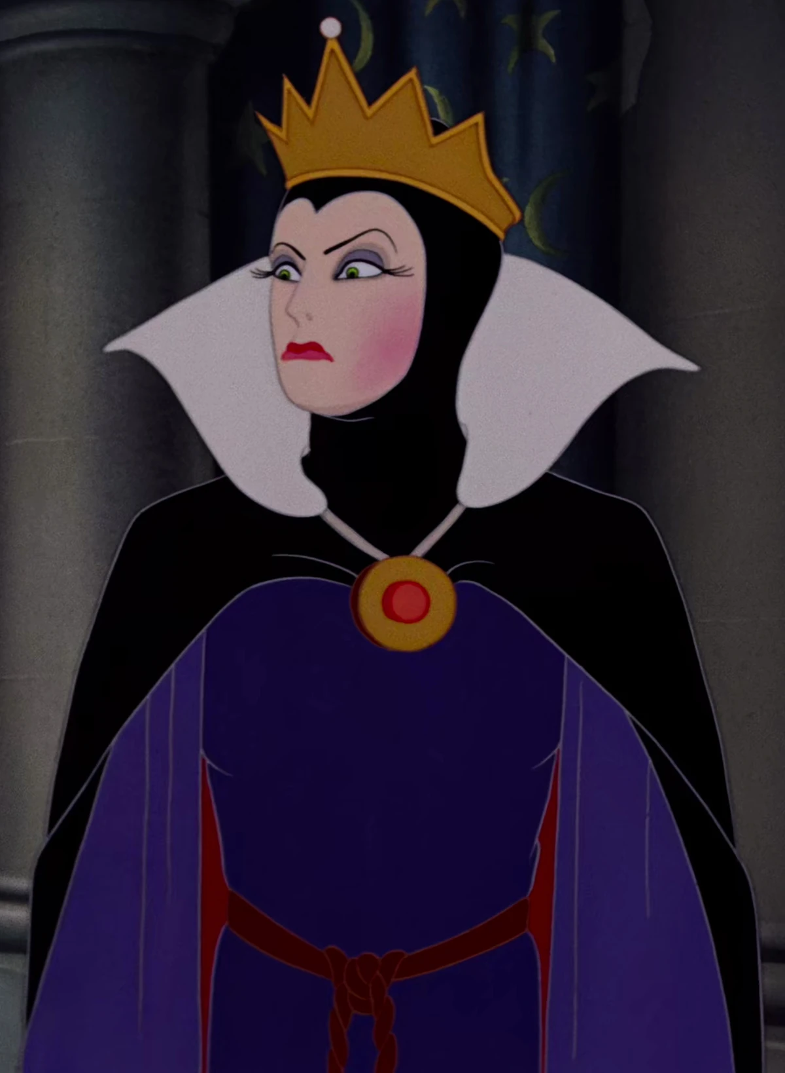
“ ‘My Queen, you are the fairest here so true. But Snow White is a thousand times more beautiful than you.’ Then the Queen was shocked, and turned yellow and green with envy. From that hour, whenever she looked at Snow White, her heart heaved in her breast, she hated the girl so much”
(Grimm & Grimm, 1857/1991, p. 173)

Slide 3
When and why do we turn green (or yellow) with envy?
self-relevant
An emotion triggered by self-relevant, upward comparisons (e.g., Parrott & Smith, 1993; Smith & Kim, 2007)
Functions as a status management tool (Crusius & Lange, 2017)
Empirical evidence points to reliable individual differences in state envy (i.e., dispositional envy)
Rentzsch & Gross (2015): Domain-Specific Envy Scale
Individual differences in envy across specific domains: Wealth, Attraction, Competence

Slide 4
Okay…why replicate?
Disadvantageous inequity by chance instead of a third-party
Anger v Envy
Dyadic interactions

Slide 5
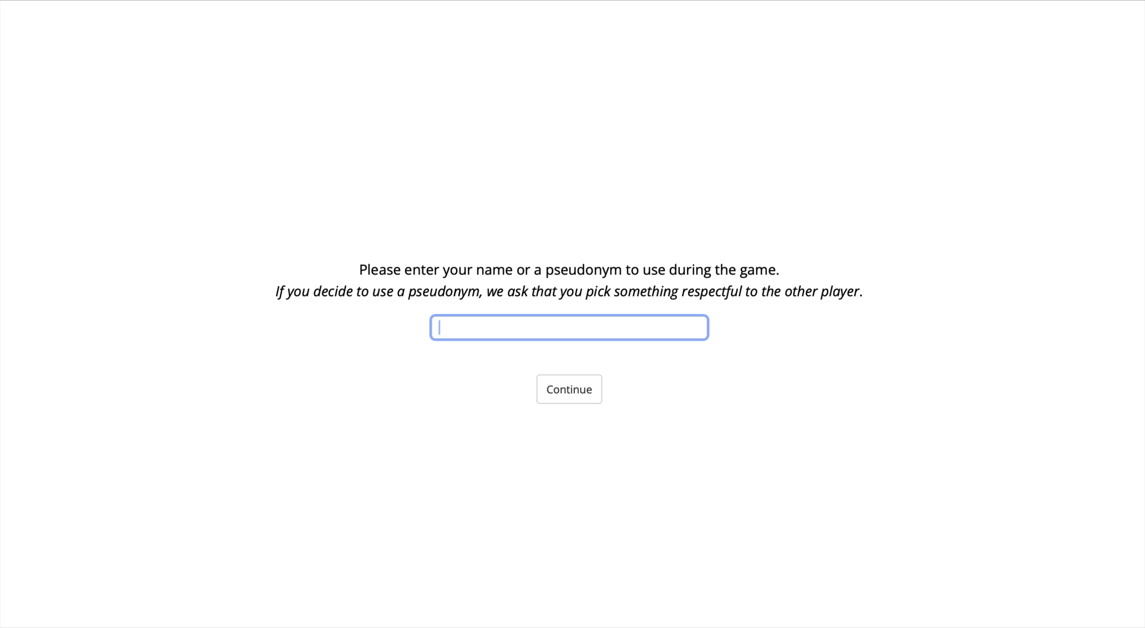
Experimental Design: Conceptual Replication
“Before arriving in the interaction lab, participants were matched by sex to dyads at zero acquaintance”
(p. 542)
Original Design
Pairing
Practice Rounds
Main Round ($)
Filler Round
SR
Measures

Slide 6
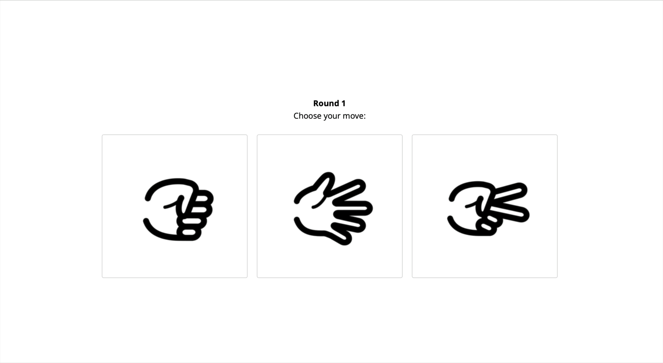
Experimental Design: Conceptual Replication
“Participants sat face to face at a table…Then, participants played a game called ‘Rock, Paper, Scissors’. The rules of the game were provided on a handout. Participants had three trials to test the game.”
(p. 542)
Original Design
Practice Rounds
Pairing
Main Round ($)
Filler Round
SR
Measures

Slide 7
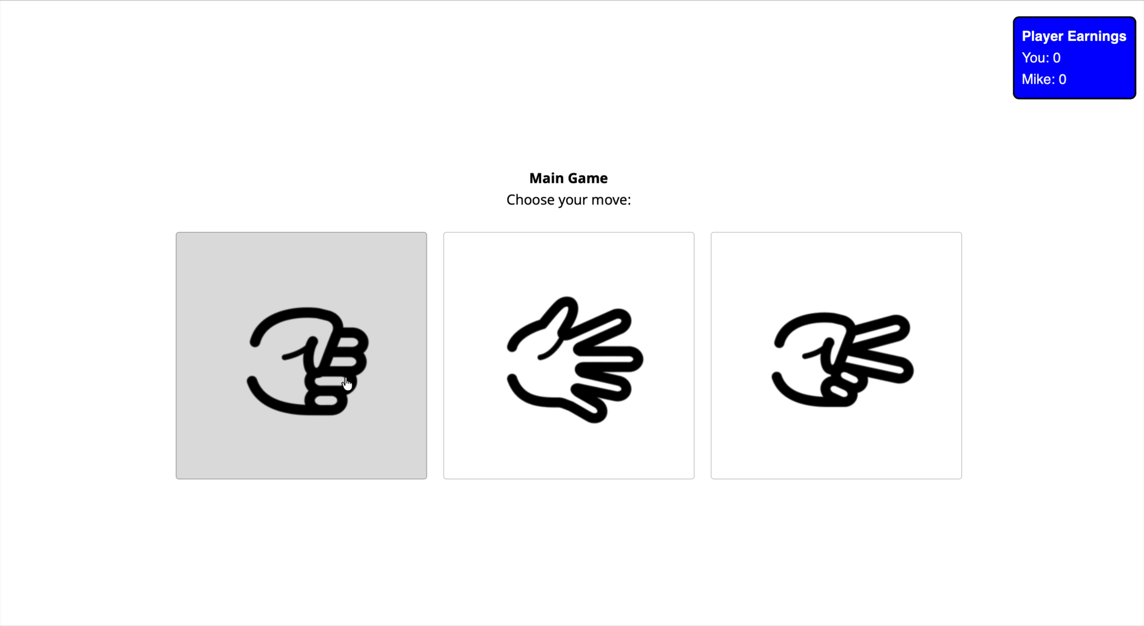
Experimental Design: Conceptual Replication
“Afterwards, the game started…the winner would receive a small reward for purposes of motivation. The reward was a highly valued chocolate bar (Milka Nussini) that was placed in an opaque box next to both participants…The winner was instructed to take the reward and leave it on the table”
(p. 542)
Original Design
Main Round
($)
Pairing
Practice Rounds
Filler Round
SR
Measures

Slide 8

Experimental Design: Conceptual Replication
“Afterwards, the game started…the winner would receive a small reward for purposes of motivation. The reward was a highly valued chocolate bar (Milka Nussini) that was placed in an opaque box next to both participants…The winner was instructed to take the reward and leave it on the table”
(p. 542)
Original Design
Main Round
($)
Pairing
Practice Rounds
Filler Round
SR
Measures

Slide 9
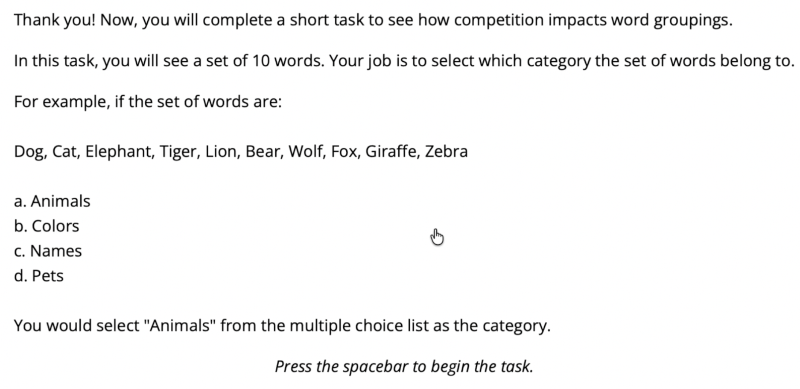
Experimental Design: Conceptual Replication
“Participants also worked on a cognitive task in which each of them was provided with a set of words that all belonged to the same superordinate category. Participants were instructed to guess the category as fast as possible.”
(supplementary materials)
Original Design
Filler Round
Pairing
Practice Rounds
Main Round ($)
SR
Measures
(Patel et al., 1997)

Slide 10
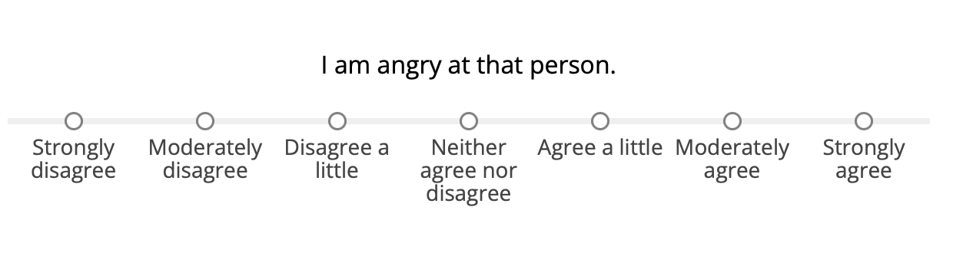
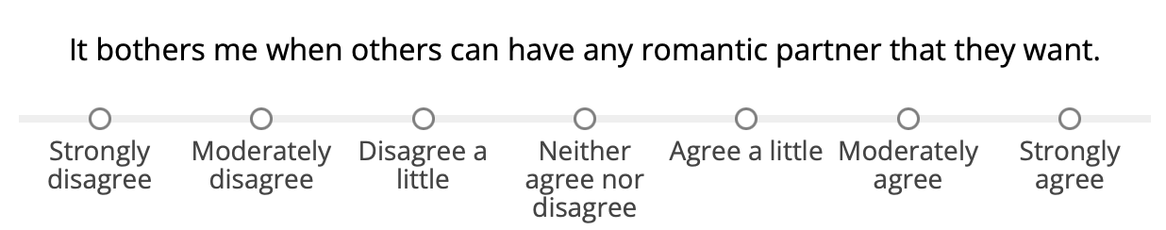
Experimental Design: Conceptual Replication
“Two weeks before meeting in the lab, participants filled out questionnaires measuring dispositional envy…Participants completed a questionnaire assessing their perceptions of the situation and their feelings towards the other person…their previous experience with the Rock, Paper, Scissors game and their attributions of the outcome of the game to luck, task difficulty, ability or effort.”
(p. 542)
Original Design
SR
Measures
Pairing
Practice Rounds
Main Round ($)
Filler Round
Self-Report DVs

Slide 11
Experimental Design: Conceptual Replication
“Two weeks before meeting in the lab, participants filled out questionnaires measuring dispositional envy…Participants completed a questionnaire assessing their perceptions of the situation and their feelings towards the other person…their previous experience with the Rock, Paper, Scissors game and their attributions of the outcome of the game to luck, task difficulty, ability or effort.”
(p. 542)
Original Design
SR
Measures
Pairing
Practice Rounds
Main Round ($)
Filler Round
Self-Report DVs

Slide 12
Experimental Design: Conceptual Replication
“Two weeks before meeting in the lab, participants filled out questionnaires measuring dispositional envy…Participants completed a questionnaire assessing their perceptions of the situation and their feelings towards the other person…their previous experience with the Rock, Paper, Scissors game and their attributions of the outcome of the game to luck, task difficulty, ability or effort.”
(p. 542)
Original Design
SR
Measures
Pairing
Practice Rounds
Main Round ($)
Filler Round
Self-Report DVs

Slide 13

Power Analysis
Cohen’s d = $\frac{2.00−1.31}{\sqrt{\frac{\left(30−1\right){\left(1.08\right)}^{2}+(29+1){(0.89)}^{2}}{30+29−2}}}$ ≈ 0.696
n = 68 participants (assuming power = 80%)

Slide 14
Disadvantageous inequity will increase envy when converting an
in-person study to an online one
Disadvantageous inequity will increase envy when converting an
in-person study to an online one, and you remove demand effects.
Disadvantageous inequity will increase envy

Slide 15
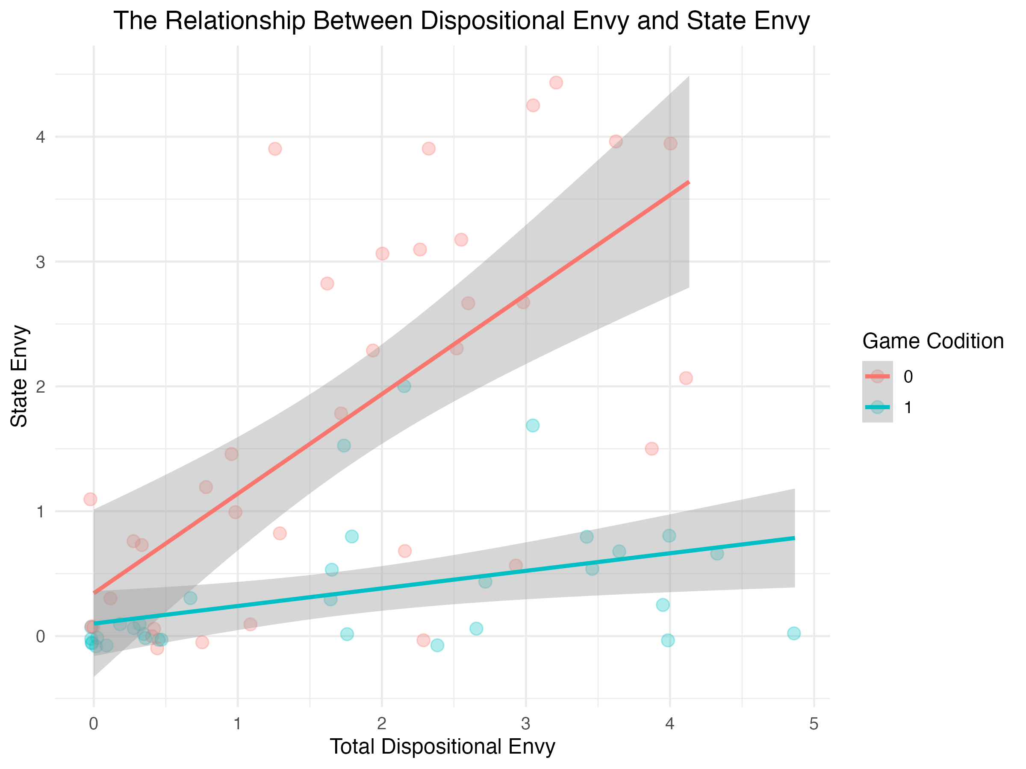
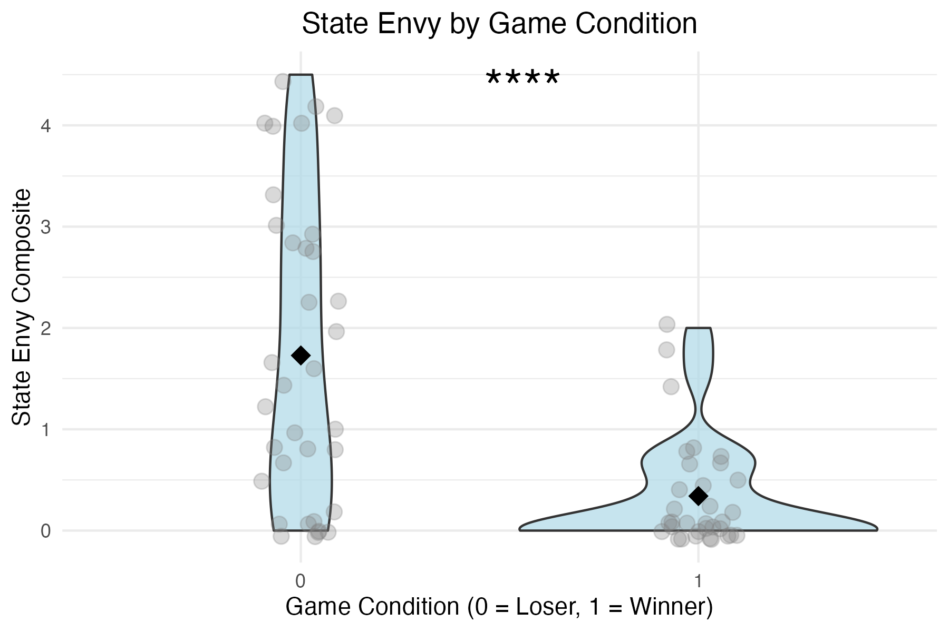
2015 results: µ₀ = 2.00 (SD = 1.08), µ₁ = 1.31 (SD = 0.89)
t(57) = 2.67, p = .01.
2015 results: Dispositional envy significantly predicted state levels of envy for the non-reward condition (β = .48, SE = 0.16, p < .01), but not for the reward condition (β = .08, SE = 0.16, p = .67)

Slide 16
2025 replication: µ₀ = 1.73 (SD = 1.50), µ₁ = 0.34 (SD = 0.54)
t(42.99) = 5.13, p < .001
2015 results: µ₀ = 2.00 (SD = 1.08), µ₁ = 1.31 (SD = 0.89)
t(57) = 2.67, p = .01.
2025 replication: Dispositional envy significantly predicted state levels of envy for the non-reward condition (β = 0.788, SE = 0.155, p < .001) and the reward condition (β = 0.141, SE = 0.055, p < 0.05)
2015 results: Dispositional envy significantly predicted state levels of envy for the non-reward condition (β = .48, SE = 0.16, p < .01), but not for the reward condition (β = .08, SE = 0.16, p = .67)

Slide 17
RENTZSCH & GROSS (2015): 1
REPLICATION CRISIS: 0

Slide 18
References
Crusius, J., & Lange, J. (2017). How Do People Respond to Threatened Social Status?
Moderators of Benign versus Malicious Envy (pp. 85–110).
https://doi.org/10.1093/acprof:oso/9780190228057.003.0004
Grimm, J., & Grimm, W. (1991). Kinder- und Hausmärchen. Rastatt: Arthur Moewig (original:
1857).
Levy, J. P., Bullinaria, J. A., & Patel, M. (1999). Explorations in the derivation of word co-occurrence
statistics. South Pacific Journal of Psychology, 10(1), 99-111.
Parrott, W. G., & Smith, R. H. (1993). Distinguishing the experiences of envy and
jealousy. Journal of personality and social psychology, 64(6), 906.
Rentzsch, K., & Gross, J. J. (2015). Who Turns Green with Envy? Conceptual and Empirical
Perspectives on Dispositional Envy. European Journal of Personality, 29(5), 530–547.
https://doi.org/10.1002/per.2012
Rentzsch, K., Giese, A.-K., Hebel, V., & Lösch, T. (2023). Personality and Emotions in Social
Interactions – The PESI Project. Personality Science, 4(1), e8241.
https://doi.org/10.5964/ps.8241
Smith, R. H., & Kim, S. H. (2007). Comprehending envy. Psychological bulletin, 133(1), 46.

Slide 19
Timeline
Background
My work
Design (pairing, practice rounds, main round, filler task, DV)
Power
Confidence
Results (with extra)

